Slide 1

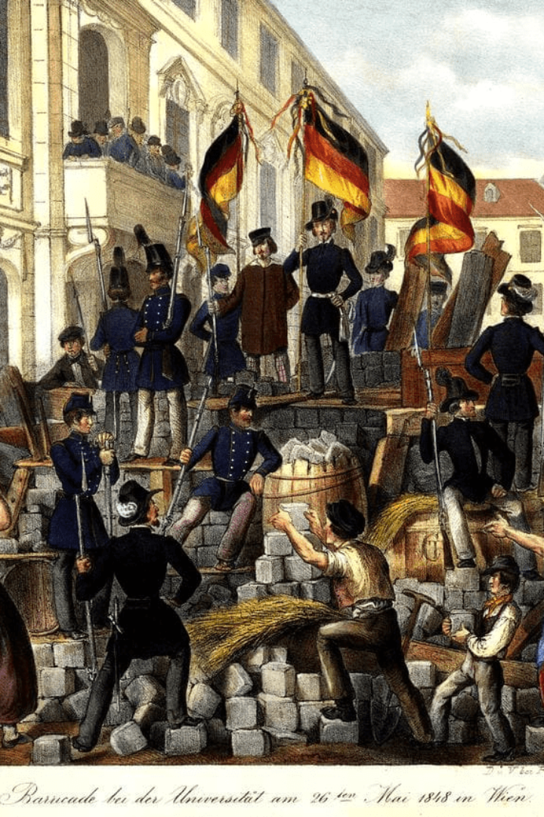


The Rise of Nationalism and Industrial Revolution
Discover the interwoven history of nationalism and industrialization in Europe, and the role of revolutionaries in shaping modern Europe.
by Dev Shukla

Slide 2

The Causes of the Rise of Nationalism
1
Economic Factors 💰
Modern economies were growing and expanding, inspiring national unity among industrialized nations for power, security, and profit.
2
Cultural Factors 🎨
Nationalism fostered a sense of unique culture and pride in one's heritage, creating a movement to assert their uniqueness and value as a people.
3
Political Factors 🏛️
New ideas of democracy and liberalism developed in Western Europe, promoting the sovereignty and autonomy of the nation-state.

Slide 3
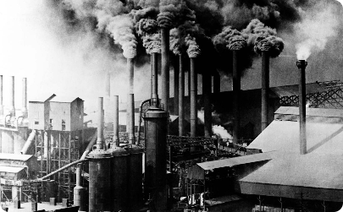
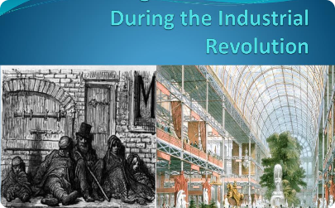

The Impact of the Industrial Revolution
Technological Advancements 🏭
Social Changes 🏘️
Economic Transformation 💹
The Industrial Revolution brought significant urbanization and migration. New social classes emerged, like the bourgeoisie and the proletariat.
New technologies created new industries, such as textiles, steam power, railroads, and mining. This facilitated the growth of industrial cities and urban areas.
New forms of labor, mass production, and international trade emerged, increasing competition and global markets.

Slide 4

The Revolutionaries and Their Contributions
Giuseppe Garibaldi 🇮🇹
An Italian revolutionary and nationalist who played a key role in the unification of Italy. He organized the Thousand, a group of nationalists who took over Sicily and Naples.
Otto von Bismarck 🇩🇪
A Prussian and German statesman who transformed Germany into a modern nation-state, using blood and iron to unify a diverse country. He became the first Chancellor of Germany.
Karl Marx 🚩
A German philosopher, economist, historian, and socialist who developed the concept of communism as a critique of the capitalist economy. He co-wrote the Communist Manifesto with Friedrich Engels.

Slide 5

Effects of the Revolutionaries' Actions
1
Unification of Italy and Germany 🇮🇹🇩🇪
Garibaldi and Bismarck contributed to the nationalist movements that led to the creation of the modern Italian and German nation-states.
2
Spread of Socialist Ideas 📚
Marx's ideas inspired socialists around the world, leading to the spread of Marxist and socialist movements.
3
Rise of Working-Class Consciousness 👷
The exploitation and poverty of the working classes inspired political action, leading to the formation of the labor movement and the rise of unions.

Slide 6
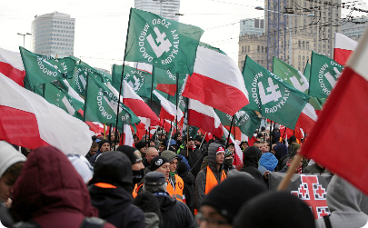


The Legacy of Revolutionaries
Nationalistic Movements Worldwide 🌏
Formation of Modern Political Ideologies 🏛️
Progress Towards Social Justice 🙌
Nationalism played a significant role in world history, contributing to the emergence of new countries and independence movements.
Nationalism, liberalism, conservatism, and socialism emerged as dominant political ideologies in the 19th century.
The ideals of the French Revolution, such as liberty, equality, and fraternity, inspired modern movements for civil rights, equality, and democracy.

Slide 7
Conclusion
The rise of nationalism and industrialization in Europe had a profound and lasting impact on our world today. The contributions of revolutionaries, such as Garibaldi, Bismarck, and Marx, continue to shape our political and social institutions. We must learn from their legacy and work towards a more equitable and just world for all.

